Slide 1
REPÚBLICA DE MOÇAMBIQUE
____
MINISTÉRIO DA AGRICULTURA E DESENVOLVIMENTO RURAL
INSTITUTO DE AMÊNDOAS DE MOÇAMBIQUE, IP
(IAM, IP)
Arab Forum For investment promotion in Mozambique
Investment Opportunities in the Almond Value Chain in Mozambique
24th July 2024, Maputo

Slide 2
I. CONTEXTUALIZATION
The Instituto de Amêndoas de Moçambique, IP (IAM,IP) has the mission of promoting the development of the almond value chain in the country, with a particular focus on cashew and macadamia crops, prioritizing the integration of family farmers.
The almond value chain involves 1.4 million mozambican families, 89 companies, and employs 14,960 workers.
Currently, the main commercially produced almonds are cashew nuts and macadamia nuts, which offer a range of investment opportunities, both in production and processing.
Investment Opportunities In The Almond Value Chain in Mozambique

Slide 3
II. CASHEW NUT VALUE CHAIN
Installed processing capacity : 110.000 Ton/year.
Average annual commercialization : 150.000 ton, with about 50% coming from Nampula province.
With government efforts, the country grafts about 8 million cashew trees per year representing only about 20% of the total;
There is potential for the private sector to exploit 80% of the total via direct support to the family sector, resulting in an additional 360.000 ton of raw cashew nuts which is expected to increase income for producers, traders, and industries, and contribute to the balance of payments through increased exports.
Investment Opportunities In The Almond Value Chain in Mozambique

Slide 4
Available Area (hectares)
Province | Available Area (ha) | Districts
Niassa | 30,000 | Cuamba, Metarica, Maua, Marrupa, Majune, Mecanhelas, e Nipepe
Cabo Delgado | 20,000 | Balama, Chiure, Montepuez e Namuno
Nampula | 20,000 | Meconta, Mongicual e Mogovolas
Zambezia | 135,000 | Maganja de Costa, Mulevala, Gile, Pebane, Mocubela, Mopeia, Lugela e Derre
Tete | 580 | Changara, Chiuta, Moatize, Mutarara
Manica | 7,321 | Machaze, Sussundenga,Gondola, Vanduzi, Macate, Guro, Macossa e Tambara
Sofala | 15,340 | Chemba, Caia, Marromeu, Maringue, Cheringoma, Gorongosa,Muanza, Dondo, Buzi, Chibabava, Machanga e Beira
Inhambane | 60,000 | Panda, Massinga, Funhalouro, Vilanculos e Mabote
Gaza | 160,000 | Mapai,Massangena, Chicualacuala e Chibuto
Maputo | 360,000 | Manhica, Magude, Moamba, Matutuine, Namaacha e Boane
Total | 808,241

Slide 5
III. INVESTMENT OPPORTUNITY IN PRIMARY PROCESSING OF CASHEW NUTS
Tab.1: Investment opportunity
Province | Processing Installed capacity (Ton) | Exploited Capacity (Ton) | Idle Capacity (Ton)
Niassa | - | -
Cabo Delgado | 7 000 | 2 000 | 5 000
Nampula | 90 715 | 29 891 | 60 824
Zambezia | 1 600 | - | 1 600
Manica | - | - | -
Sofala | - | - | -
Inhambane | 1 000 | - | 1 000
Gaza | 8 000 | 3 949 | 4 051
Maputo | 500 | 48 | 452
Total | 108 815 | 35 888 | 72 927
Source: IAM-IP, 2023
Investment Opportunities In The Almond Value Chain in Mozambique

Slide 6
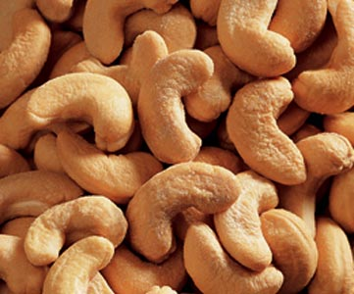
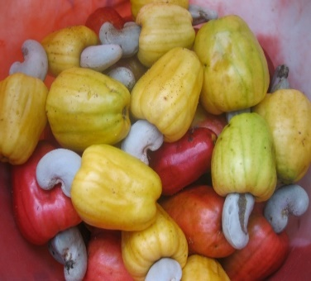
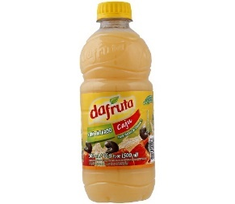
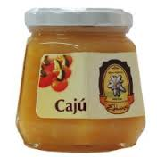
Investment Opportunities In The Nut Value Chain
Cashew
kernel
Confectionery
CNSL
Resin
leather
Varnishes
Pharmaceutical products & Cosmetics
Butter
flour
Milk
Paint
Borracha sintética
Pulp
Pseudofruit
syrup, nectars,
Vinegar …
Juice
Soft drinks
Animal food
Flour
Cashew powder
Fruit compotes
Jelly
Raisins
pectin
Hambuguer
Dried pear
SOURCE: IAM-IP, 2024

Slide 7
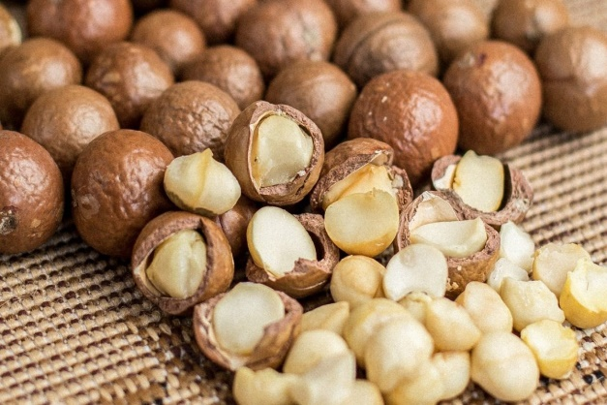
IV. MACADAMIA VALUE CHAIN
On a global level, macadamia nuts are considered one of the most highly regarded and nutritionally valuable nuts on the market, utilized in a multitude of applications in the food, pharmaceutical, and cosmetics industries.
Due to the trend towards healthier products, there has been notable growth in the markets of the EU, Nordic countries, and the Middle East, presenting significant potential.
With competitive advantages stemming from agro ecological factors, the country boasts approximately 242,000 hectares suitable for expanding macadamia production areas.
Investment Opportunities In The Almond Value Chain in Mozambique

Slide 8
Available Area (hectares)
Province | District | Available Area(ha)
Niassa | Lichinga | 3,481
 | Chimbunila | 3,870
 | Sanga | 1,380
 | Majune | 5,000
 | Muembe | 110,000
 | lago | 50,000
 | Ngauma | 600
Cabo Delgado | Balama | 5,000
Zambezia | Ile | 570
 | Molumbo | 1,140
 | Gurué | 2,100
 | Milange | 400
 | Namarroi | 10,800
Manica | Barue | 5,600
 | Sussundenga | 1,394
 | Mussorize | 6,750
 | Manica | 1,672
 | Macate | 500
 | Vanduze | 1,250
 | Gorongosa | 425
Tete | Tsangano | 400
Sofala | Gorongosa | 2,000
 | Cheringoma | 150
 | Dondo | 100
 | Chibabava | 200
 | Machanga | 100
Inhambane | Govuro | 983
 | Massinga | 31
 | Morrumbene | 11
 | Jangamo | 391
Gaza | Bilene | 300
 | Limpopo | 1,400
 | Chizavane | 300
Maputo | Matutuine | 7,000
 | Namaacha | 4,500
 | Boane | 2,000
 | Manhica | 600
 | Moamba | 10,000

Slide 9
V. EXPORT OF RAW CASHEW NUTS AND MACADAMIA
Volume of raw cashew nuts and macadamia exported in the last 6 campaigns
Campaigns | Raw cashew nut (Tons) | Macadamia (Tons)
2018/29 | 24,333.97 | 955
2019/20 | 33,747.07 | 1,228
2020/21 | 27,370.46 | 2,269
2021/22 | 53,759.60 | 2,384
2022/23 | 60,376.46 | 3,905
2023/24 | 48,425.55* | 646*
Source: Customs of Mozambique
* Export in progress
Investment Opportunities In The Almond Value Chain in Mozambique

Slide 10
VI.GUARANTEES AND FISCAL INCENTIVES UNDER THE INVESTMENT LAW
Protection of property rights: The State guarantees the security and legal protection of property over assets and rights including industrial property rights;
The legal protection of the right to use and exploit land;
Transfer of funds abroad : The state guarantees, according to the conditions established in the respective authorization or other relevant legal instruments related to the investment, the transfer abroad of :exportable profits, “royalities” or other income from indirect investments, amortizations and loan interests, foreign invested and re-exportable capital.
Investment Opportunities in the Almond Value Chain in Mozambique

Slide 11
VI. GUARANTEES AND FISCAL INCENTIVES UNDER THE INVESTMENT LAW
The state guarantees the granting of fiscal and customs incentives as outlined in the Tax Benefits Code for Investments in Mozambique;
Companies established with foreign direct investment participations may benefit from access to domestic credit, in the same terms and conditions applicable to Mozambican companies, and in accordance with the current legislation in the country.
Investment Opportunities In The Almond Value Chain in Mozambique

Slide 12
VI. GUARANTEES AND FISCAL INCENTIVES UNDER THE INVESTMENT LAW
Allocation of Foreign Currency: For enterprises engaged in foreign exchange generating activities, the central national bank may authorize the retention, in a foreign currency account, of a portion of the revenues generated by them;
The Cashew Law: Law nº 09/2023 of July 20 , recently approved Will consolidate the legal framework of the cashew value chain, adapting it to current demands of the national and international markets, stimulating competitiveness among stakeholders, ensuring the necessary security and tranquility for investments in the Cashew Subsector.
Investment Opportunities in the Almond Value Chain in Mozambique

Slide 13
VII. Economic Acceleration Measures Programme (EAP) – Mozambique
The Government of the Republic of Mozambique announced the launch of the Programme of Economic Acceleration Measures (henceforth "EAP") on 9 August 2022, a programme comprising a package of twenty reform measures aimed at resuming economic growth. Of the 20 reform measures, we highlight 3 that have a direct impact on the almond subsector, namely:
Exemption from VAT on the import of production factors for agriculture and electrification, with the aim of reducing the costs of agricultural inputs so as to promote production and competitiveness in the agricultural sector and to promote investment in renewable energies to accelerate their access allowing their arrival in rural areas;
Investment Opportunities in the Almond Value Chain in Mozambique

Slide 14
VII. Economic Acceleration Measures Programme (EAP) – Mozambique
Lower the IRPC rate from 32% to 10% in agriculture, aquaculture and urban transport so as to improve competitiveness in these sectors (making them more attractive to private investment), reduce the deficit and the cost of public transport. Also as part of promoting the competitiveness of the agricultural sector, the government will reduce the withholding tax levied on foreign entities that provide services to national agricultural companies from 20% to 10% and eliminate the withholding tax of 20% on interest on external financing for agricultural projects;
Simplify the procedures for repatriation of capital, in order to facilitate the flow of capital to attract more foreign investment and reduce costs;
Investment Opportunities in the Almond Value Chain in Mozambique

Slide 15
VII. FINAL CONSIDERATIONS
Mozambique has vast potential for investments in the almond chain, including:
Availability of 800,000 hectares for establishing new cashew plantations;
Approximately 242,000 hectares suitable and available for macadamia planting;
Potential to implement new primary and secondary processing units;
High potential to optimize the versatility of false cashew fruit derivatives;
Prospects for increasing production to 268,000 and 18,000 tons/year for cashew and macadamia until 2029; and
Very favorable legal framework for foreign investment.
Investment Opportunities in the Almond Value Chain in Mozambique

Slide 16
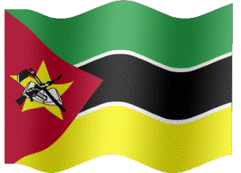
Address
Rua da Gávea, nr 33
1-3º Andares
Email: iam@iam.gov.mz
Maputo-Moçambique
General Manager: Ilidio Bande
Email 1: ilidio.bande@iam.gov.mz
Email 2: bande.ilidio@gmail.com
Contact: + 258 843 025 326 or +258 873 025 325
Presentation Access
https://iam.gov.mz/index.php/forum-arabe-de-promocao-de-investimento-em-mocambique/
Investment Opportunities in the Almond Chains in Mozambique

