Slide 1



Investment Forum
Mozambique - Árabe
July 2024

Slide 2


Content
01
BANKING SECTOR
PERFORMANCE INDICATORS
02
MILLENNIUM BIM
CONTRIBUTION TO THE ECONOMY

Slide 3
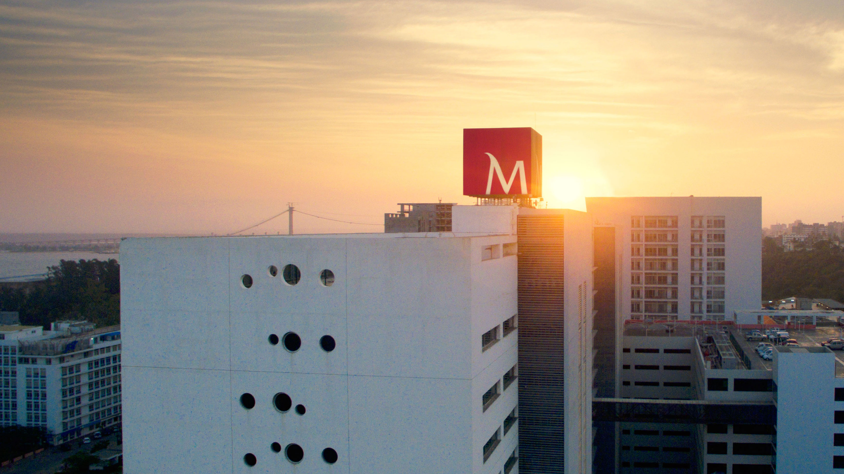
1
Banking Sector
PERFORMANCE INDICATORS

Slide 4
Financial inclusion showed increasing across the country, as a result of on-going investments in improving banking services
Banking Cards
Million
Banking Accounts
Million
1,1x
1,2x
The number of bank accounts grew because of investments in expanding the network of branches and banking agents in the country
EMI accelerated financial inclusion
New players has increased competition in the sector
Source: Bank of Mozambique
*EMI – Electronic Money Institutions

Slide 5
The banking sector continues profitable despite the challenging context related to high interest rates and lower economic activity
Deposits
MZN Thousand Million
Credit
MZN Thousand Million
1,7x
1,2x
Despite macroeconomic and climatic challenges, the banking sector remain stable, maintaining a comfortable liquidity to support business and households
The total assets of the sector have grown by 37% since the pre-pandemic
Assets
MZN Thousand Million
Source: Bank of Mozambique, National Statistic Institute

Slide 6
... while deleveraging in balance sheet given the restrictive monetary conditions
The credit flows has slowed down due to the restrictive monetary policy to fight inflationary pressures
High interest rates in the money market have affected credit demand in most sectors, a situation that is expected to reverse in 2024 with new cuts in the policy interest rate (MIMO)
Credit by Sector
YoY
Source: National Statistic Institute, Bank of Mozambique

Slide 7
2
Millennium bim
Contribution to the Economy

Slide 8
Millennium bim has been a partner in the growth of Mozambique’s economy …
Total Asset
MZN Million
Net Profit
MZN Million
We are the most efficient bank in the financial system (cost-to-income 45.2%, 2022-23)
Most capitalized bank in the financial system (Tier 1 39.5%, 2022-23)
We generate adequate profitability (ROE 20.5%, 2022-23) which has allowed the payment of dividends over the years
ROE
2023
Tier 1
2023
21,1%
40,1%
Source: Financial Statements

Slide 9
… contributing to boosting banking operartions and promoting financial inclusion
195
465
8 800
Quota BIM: 30%
Branches
Quota BIM: 32%
Investment in the banking network has allowed the expansion of BIM services to almost all districts
ATM
Quota BIM: 26%
Today we are closer to the population, and we are an active agent in the banking of the Mozambican economy
POS
Note: Data related to 2023

Slide 10
A Bank focused on the Future
O Millennium bim has a clear vision and mission
MISSION
VISION
Creating value for Mozambican society
A reference institution in the economy
providing quality banking services to individuals and companies
contributing for private sector development
generating adequate profitability for the shareholder
which is focused on enhancing its competitive advantages
having levels of solidity, profitability, service and efficiency in line with best practices
10

Slide 11


Our strategic plan is based on 6 pillars of
transformation, with each of the pillars aligned around priorities
To be a leading bank in customer service
Continue to transform Millennium bim into a profitable bank
1. Quality and innovation
4. Profitability and efficiency
Exemplo de Título
2. Leadership and value proposal
5. Consolidation of governance strategy
3. Sustainability and social impact
6. People, culture and transformation

Slide 12

Millennium bim
Support to Foreign Investors
Coverage of the main financial centers through correspondent first tier banks from USA, London, Japan, the European Union and South Africa.
We assist throughout the process of registering FDI, shareholders loans, and foreign currency operations.
Extensive commercial network with geographic coverage in all provinces, further strengthened by the reopening of the branch in Palma.
High consistency of the transactional base, provision of excellent digital services, and interoperability with all electronic currency institutions.

Slide 13
We are the most awarded Bank in Mozambique offering innovative financial solutions to support local companies
Investment
Treasury
Trade Finance
Accounts
Services
Long Term
Facilities
Short Term
Facilities
Trade Finance
Solutions
Transactions
flows
Current
Payments
Leasing
Term Loans
Bank Guarantees
Bridge Finance
Local Tranche Facility
On-shore Banking
Overdraft
Revolving Credit
Factoring
Confirming
Invoice Discount
International Transfers
Letter of Credit
FX products
International Bank Guarantees
Deposits
Internet Banking
Cards (credit and debit)
Cash Management
Access to Dealing Room
POS / Ecommerce
Cash Directo
Services payments
Payments to the Social Security
CUSTOMIZATION OF:
• Host to Host solutions;
* Solutions for the Supplier Ecosystem, whether in transactionality or in the availability of liquidity and trade finance facilities.

Slide 14


