Slide 1
REPÚBLICA DE MOÇAMBIQUE
Niassa Macadamia Limitada
Arab Forum For investment promotion in Mozambique
Niassa Macadamia Experience as a investor developer to include the small growers with a core project
24th July 2024, Maputo

Slide 2
GROWING THE SINGLE BIGGEST MACADAMIA LOCAL INTERGRATED VALUE CHAIN
Niassa Macadamia Limitada

Slide 3
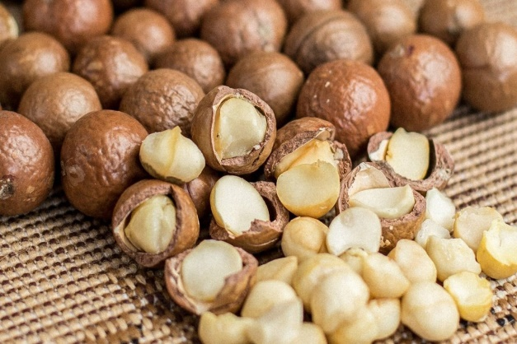
What is Macadamia
On a global level, macadamia nuts are considered one of the most highly regarded and nutritionally valuable nuts on the market, less than 2% of global tree nut bascet,utilized in a multitude of applications , viewed as a Superfood, in the food, pharmaceutical, and cosmetics industries.
Due to the trend towards healthier products, there has been notable growth in the markets of the EU, Nordic countries, and the Middle East, presenting significant potential.
With competitive advantages stemming from agro ecological factors, the country boasts approximately 242,000 hectares suitable for expanding macadamia production areas.
Niassa Macadamia Limitada

Slide 4
About Us
Niassa Macadamia is a Agricaltural Enterprise established in 2016 in Niassa it already has 1233Ha planted & is poised to achieve sustaiable crop production from 2027.
Currently, the main commercially produced products is subsistance farming maize and beans, short term cash crops , we are intrudusing over a 8 year training period, of Macadamia Nuts Production, Uplifting Communities . Reabilitating degraded land
First Commercial Production for Export October 2025, processing fully operational may 2026
NML will build the first complete Processing Plant in Mozambique 4000 tons NIS capasity, this will be a catalyst for more development
Niassa Macadamia Limitada

Slide 5
About Us
Phase 1 initial establishment of 1000+ ha completed
Phase 2b (Concurrent to 2a) Build fulL macadamia Processing Plant 4000 tons NIS
Phase 3 Expand the planted area by a further 2000Ha ones phase 2 is sustainable, government strategic plan for 10,000ha
Phase 2ª establish a futher 2000Ha of Orchards aincluding Small holder farmers (Ep´s)
Niassa Macadamia Limitada

Slide 6
Market
The Global Macadamia market size was valued at U$D1,58billion in 2022and is anticipated to expand at a compound annual growth rate (CAGR) of 9,3% from 2023 to 2030
Phase 2b (Concurrent to 2a) Build fulL macadamia Processing Plant, 4000 tons NIS
Phase 3: Expand the planted area by a further 2000Ha ones phase 2 is sustainable
The increase in production sites are still lagging the global population growth
Niassa Macadamia Limitada

Slide 7
Risks are minimized by the following Factors
Ideal Climate and Habitat, Elevation 1200m ASL, rainfall 1100mm p.a. (50 year Ave)and very fertile soil, reliable water sources, not reliant on irrigation
Politial Risk is minimised through strong Goverment support for Agricaltural investment with strong support from key provincial and National departments and Key Ministries
Labour Risk , disruptive labour action is mitigated by our inclusive model that supports Smallholder Initiative were the investor and labour force will work the land as a collective.
Access to Market, new railway connection to Nacala Port, Excellent new tar main road a access with good secondary roads to farm and processing facility.
Niassa Macadamia Limitada

Slide 8
Winners
Communities of Chimbunila
Provincial Government of Niassa Province
National Government of Mozambique
Key Ministries of Mozambique
APIEX
European DFIs
Niassa Macadamia Limitada
Izak C Holtzhausen (founder)
William P Melendez (founder)
Niassa Macadamia Limitada

Slide 9
Thank You
For More Information:
Izak C Holtzhausen
Niassa Macadamia Limitada
Lichinga
izak@smops.co.mz
+258 843033780

