Slide 1

AMER PRESENTATION FOR ARAB INVESTEMENT FORUM - MOZAMBIQUE
25 JULY 2024

Slide 2

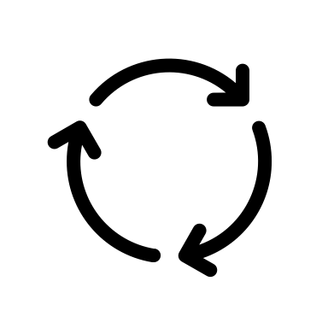




WHO WE ARE
The Mozambican Association of Renewable Energies (AMER) was founded in 2017 and seeks to foster the growth of the renewable energy sector in order to create a “cleaner and more sustainable” future for Mozambique and its population.
AMER's mission is to respond to the needs of its members and add value and power, with a joint voice and in coordinated action.
  AMER works on three strategic pillars:
      access to opportunities
      Knowledge sharing and thought leadership
      Awareness: visibility, awareness and advocacy

Slide 3
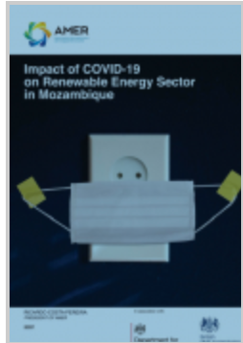
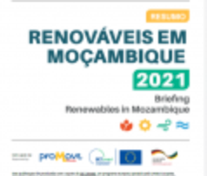
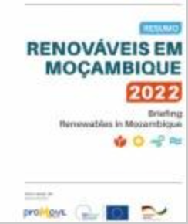
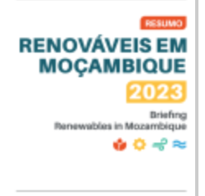
WHAT IS OUR VALUE PROPOSITION FOR MEMBERS
One stop shop for sector information, data and statistics – Annual Publications “Summary of the Sector”
Updated Sector News – National and International - Continuous
Business Opportunities – including public tenders - Continuous
Direct Access to All Members
Support and Advice - Finance, Technical and Financial)
Access to Partnerships with Members and Non-Members
Employment Platform Training Courses
Webinars
National And International Conferences – Renewables in Mozambique – November 2024 (27th and 28^{th)}

Slide 4
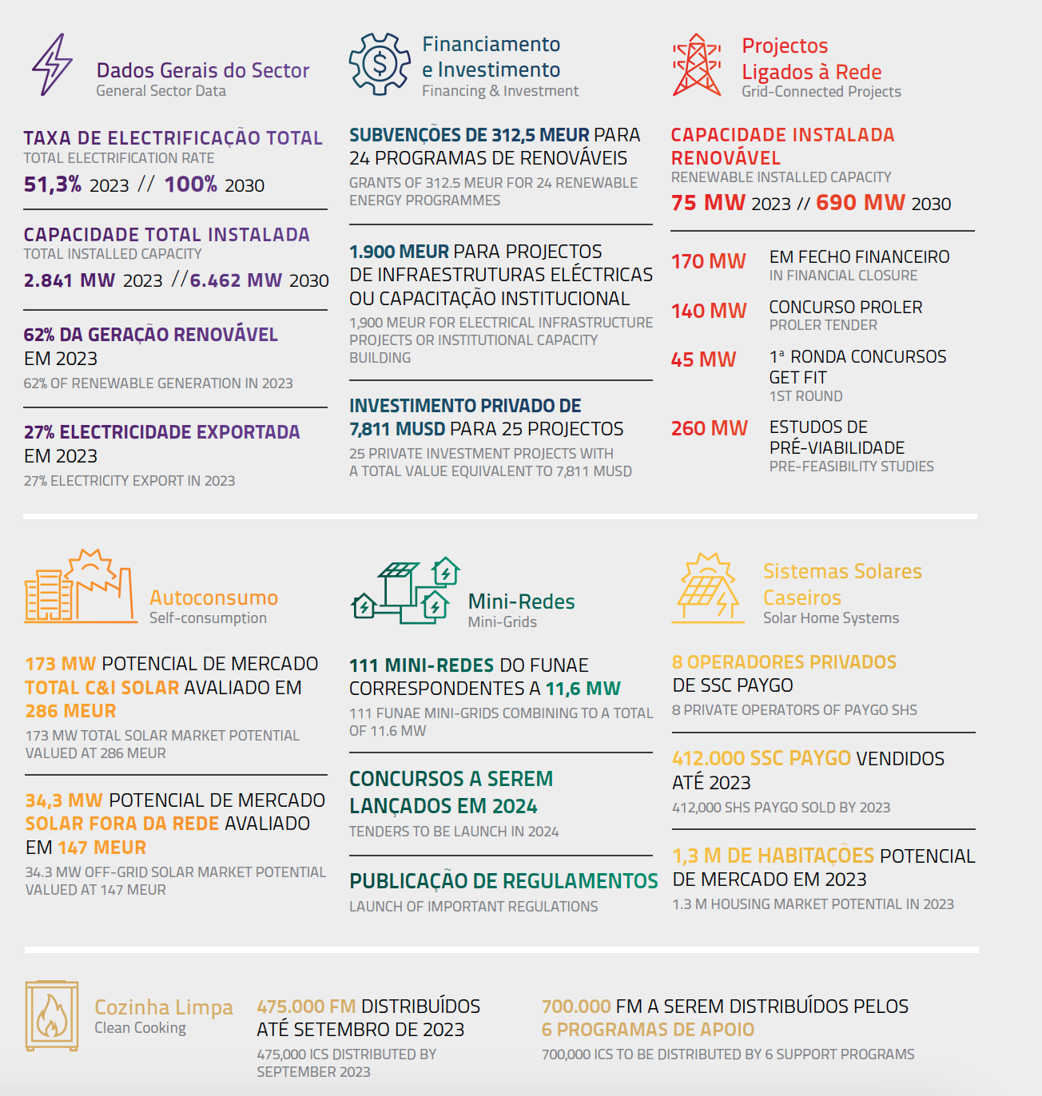
KEY STATISTICS

Slide 5
KEY STATISTICS

Slide 6
REGULATORY FRAMEWORK WITH SPECIAL INTEREST FOR RENEWABLES
Current and Approved
To be developed
Energy Transition Strategy
Revised Electricity Law – approved and published (into force in October 2022)
Off-grid regulation (mini-grids and energy services (SHS and ICS)
National Electrification Strategy
Renewable Energy Strategy
Subsequent regulations for the off-grid regulations (grid integration, tariff harmonization, ect)
Subsequent regulations for Electricity Law
Renewable Energy Grid Code
Local Content Regulation
Carbon Market Regulation

Slide 7
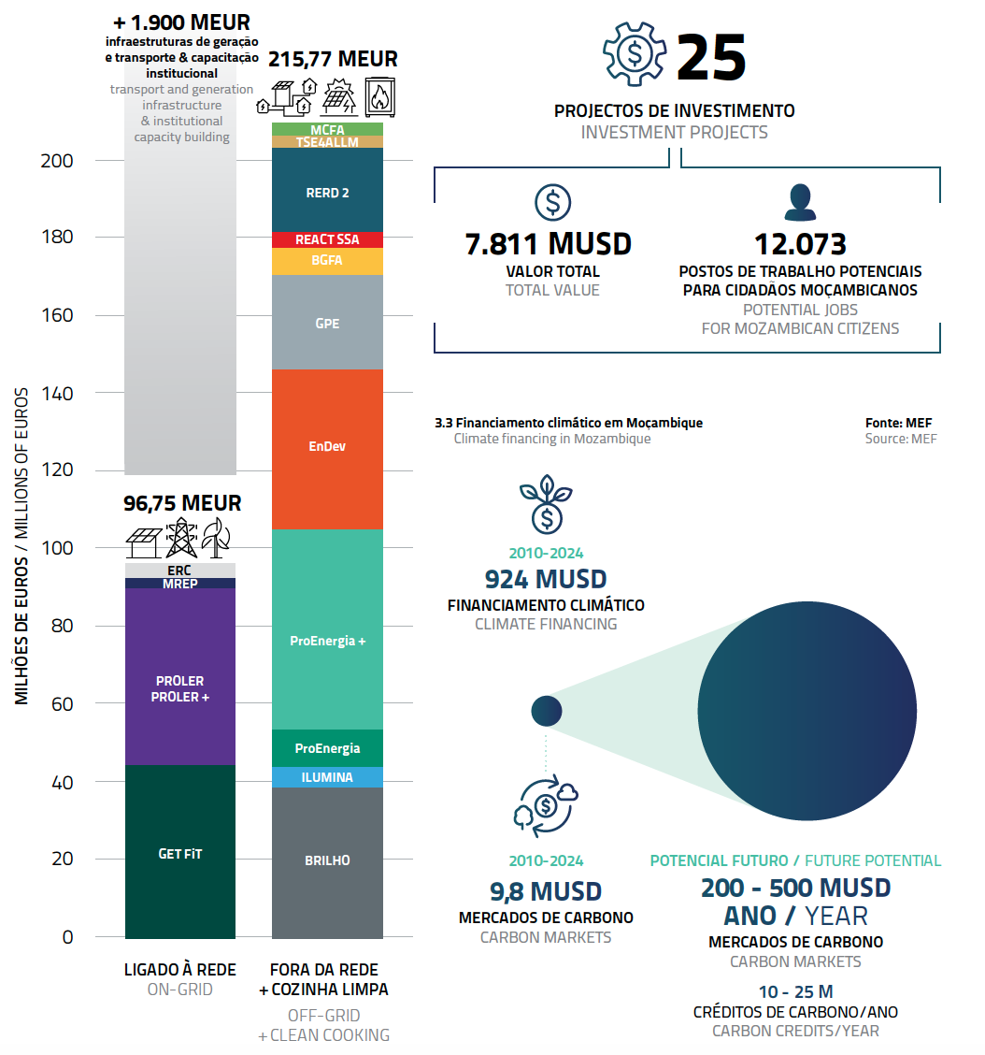
INVESTMENT AND FINANCING
International partners provide financial support for renewable energy, with 24 programs totaling 312.5 MEUR.
Over 1,900 MEUR has been invested in infrastructure and capacity building for integrating renewable energies.
Commercial banks offer limited financing; international funds have mobilized significant support through specific credit lines and investment programs.
Mozambique raised 924 MUSD through climate funds and aims to produce 10-25 million carbon credits annually, with ongoing projects and participation in the African Carbon Markets Initiative.

Slide 8
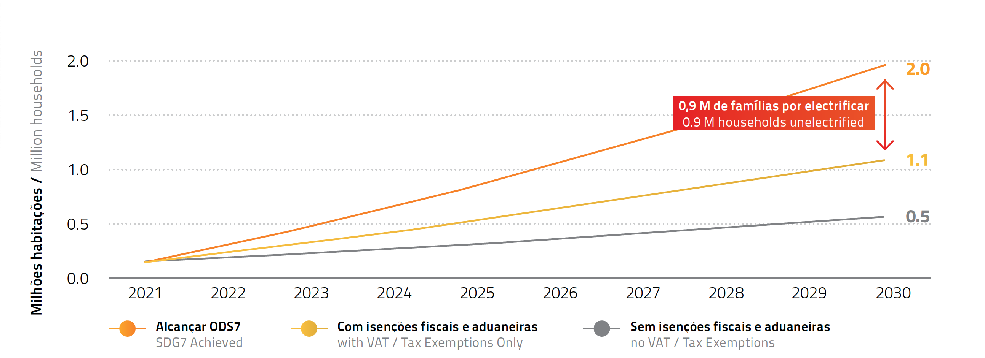
OPPORTUNITIES IN RENEWABLE ENERGY
Notes:
1. **Achievement of SDG7**:
- The orange line indicates the target to achieve Sustainable Development Goal 7 (SDG7), which aims for universal access to affordable, reliable, and modern energy services by 2030. By following this trajectory, 2.0 million households in Mozambique will be electrified by 2030.
2. **Impact of Tax Incentives**:
- The yellow line shows the projected number of electrified households if VAT and other tax exemptions are applied. By 2030, this approach would result in 1.1 million households gaining access to electricity. This highlights the significant positive impact of fiscal incentives on expanding energy access.
3. **Limited Progress Without Tax Exemptions**:
- The gray line represents the scenario without any VAT or tax exemptions, resulting in only 0.5 million households being electrified by 2030. This starkly contrasts with the other scenarios, emphasizing the critical role of financial incentives in accelerating electrification efforts.
4. **Electrification Gap**:
- Despite the efforts, even with tax exemptions, there remains a considerable gap in achieving universal electrification. By 2030, 0.9 million households would still be unelectrified if only VAT and tax exemptions are implemented, compared to the SDG7 target. This underscores the need for additional measures and investments to fully achieve universal energy access.

Slide 9
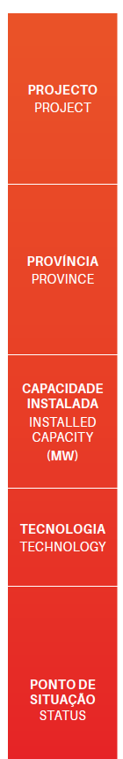
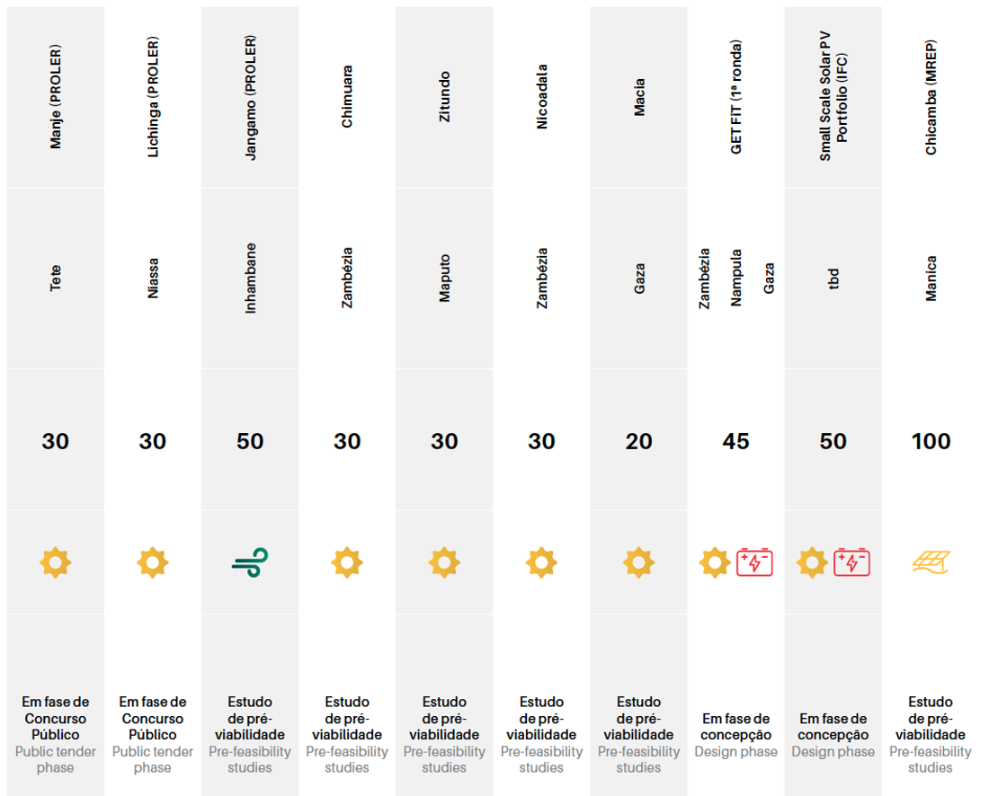

OPPORTUNITIES IN RENEWABLE ENERGY

Slide 10
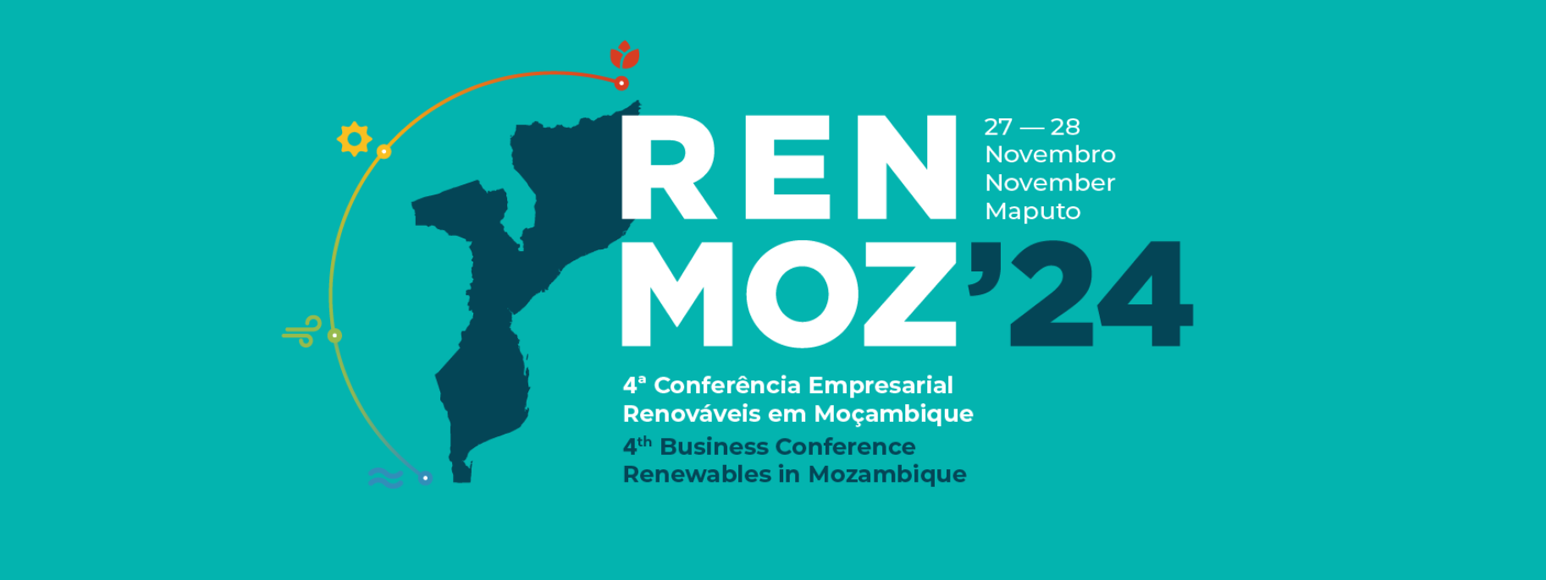
COMING UP!

Slide 11

THANK YOU
contact@amer.org.mz

