Slide 1
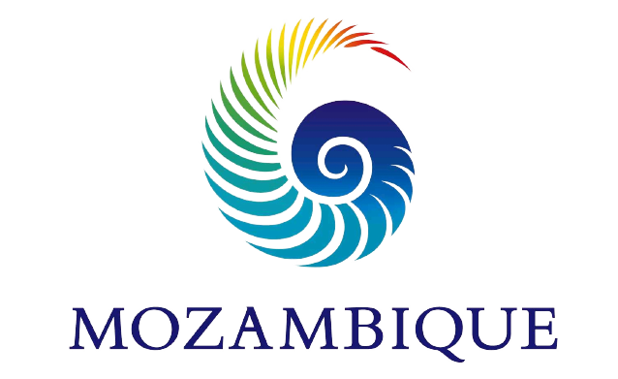
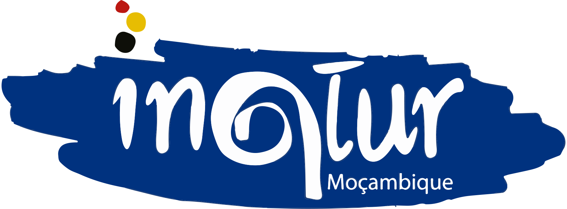
TOURISM
Investment Opportunities

Slide 2
Vision for the future
To develop and position Mozambique as Africa's most vibrant and dynamic Premium Tourism destination, with an emphasis on:
Promote the use of cultural and natural heritage;
Develop tourist routes and circuits; in the five priority Destinations
Investing in the use of information and communication technologies;

Slide 3
Why Visit Mozambique?
Mozambique has the potential to be among the premier destination in Africa for its quality coastal resorts, a diversity of flora and fauna, eco-tourism, adventure and culture experiences’, enormous tourism investment opportunities.

Slide 4
TOURISM STRATEGIC FRAME
Tourism Policy
Strategic Tourism Development Plan
Marketing Strategy
Other Sectors Strategies (Environment, Aviation, Land…)

Slide 5
EViSA &Visa Free
On the 5th of December 2022 2022, Mozambique launched the electronic visa issuing system (e-visa).
On the 14th of March the Council of Ministers approved visa exemption for 29 countries for tourism and business. The exemption applies to visitors holding ordinary passports and allows for a 30-day stay, renewable to an additional 60 days.
“It Starts with a Click”
www.evisa.gov.mz

Slide 6
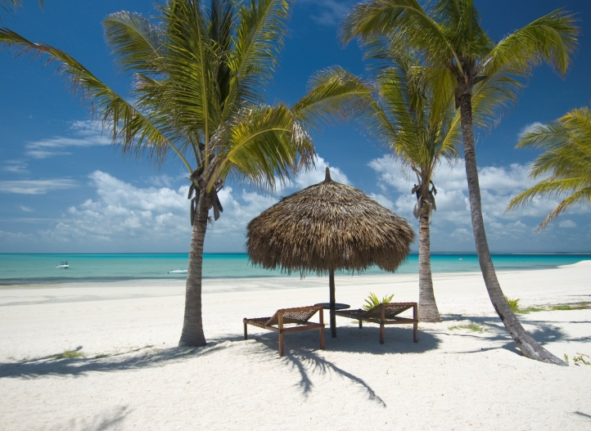
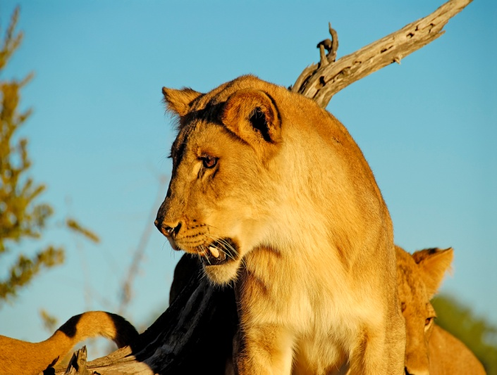
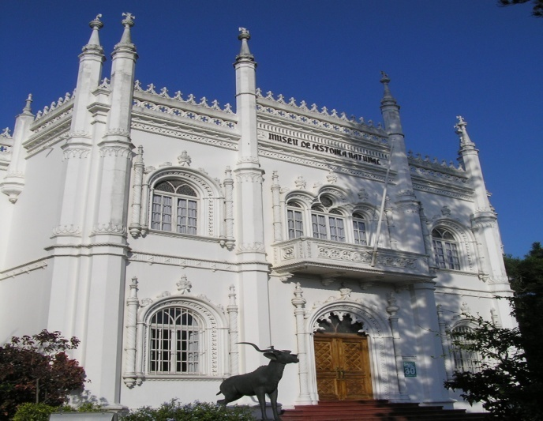
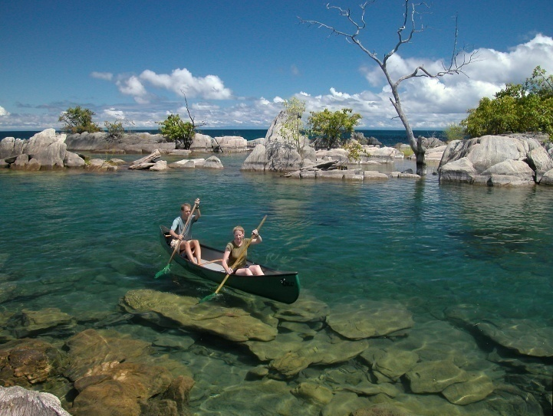
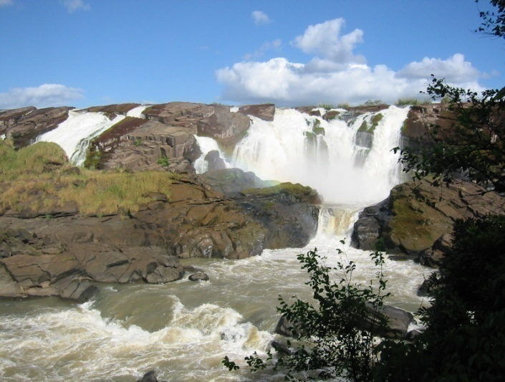
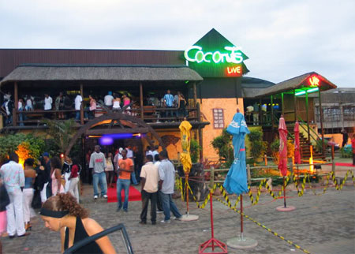
TOURISM PRODUCTS
Sun, Sand and Sea
Eco Tourism
Culture
Water Sports
Adventure
Entertainment
6

Slide 7
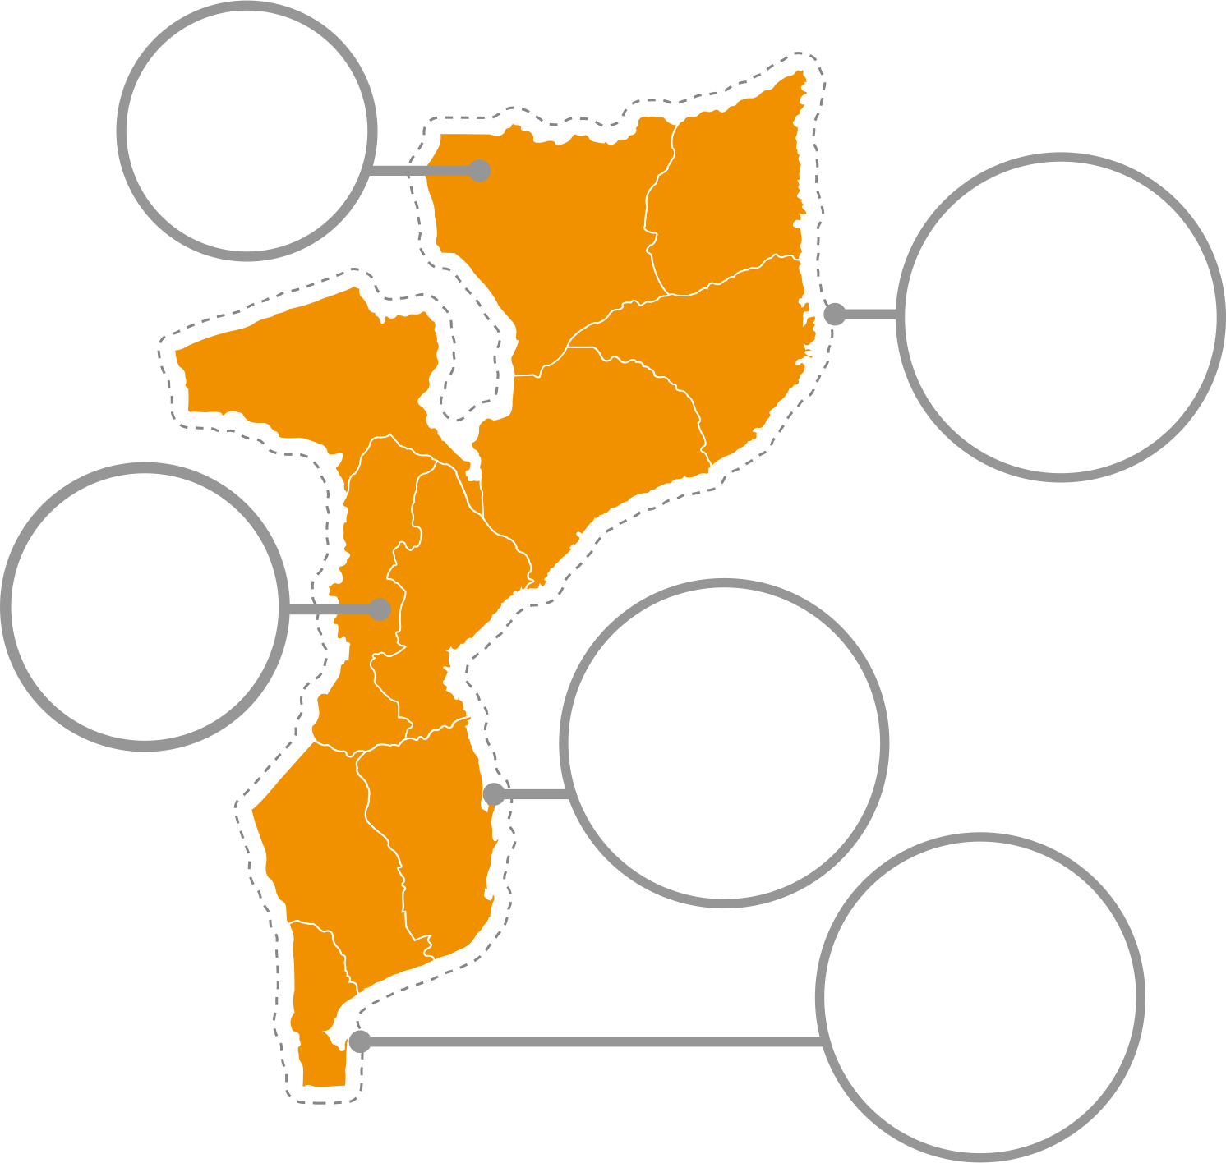
Niassa
Ecotourism
Quirimbas
Sun sand, Sea
& culture
Priority Destination
In line with the implementation of the five year plan, the government approved five priority areas each with specific action focused in short , medium and long term plans that would transform the tourism sector into a real industry with peace and progretion that will contribute to job creation and the well being of the local communities.
Gorongosa
Adventure
Vilankulo
Sun, sand
& beach
Maputo
Business,
Culture &
MICE

Slide 8
Tourism
Investment Opportunities

Slide 9
Maputo National Park – Ponta Dobela
PONTA DOBELA ECOTOURISM RESORT
Operator sought for mid- to high-range resort on a protected bay with rich birdlife along estuary. Area encompasses riverine forest, freshwater lakes and several kilometers of wide sandy beachfront.
Beach and eco units, 3 beach bars, 3 spas, 2 gyms, central hub with reception, restaurant and small event/meeting venue.
CAPACITY: 100 beds
ACTIVITIES: Birding, game viewing and marine activities
Estimated Budget: 10 million USD

Slide 10
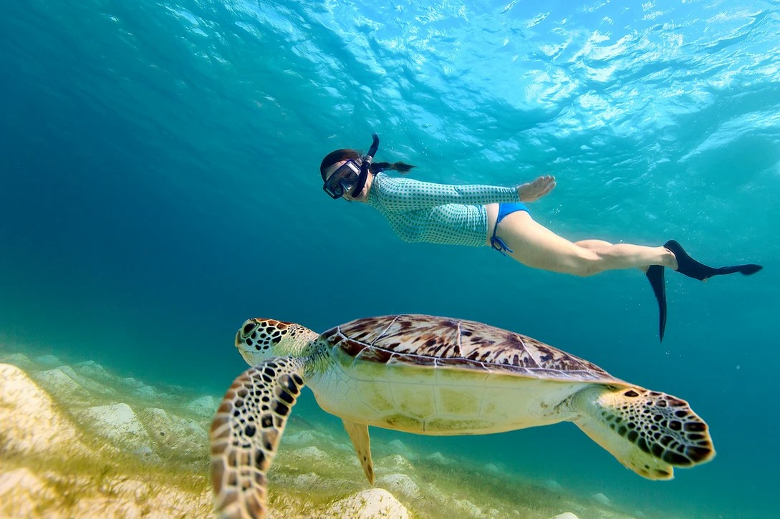
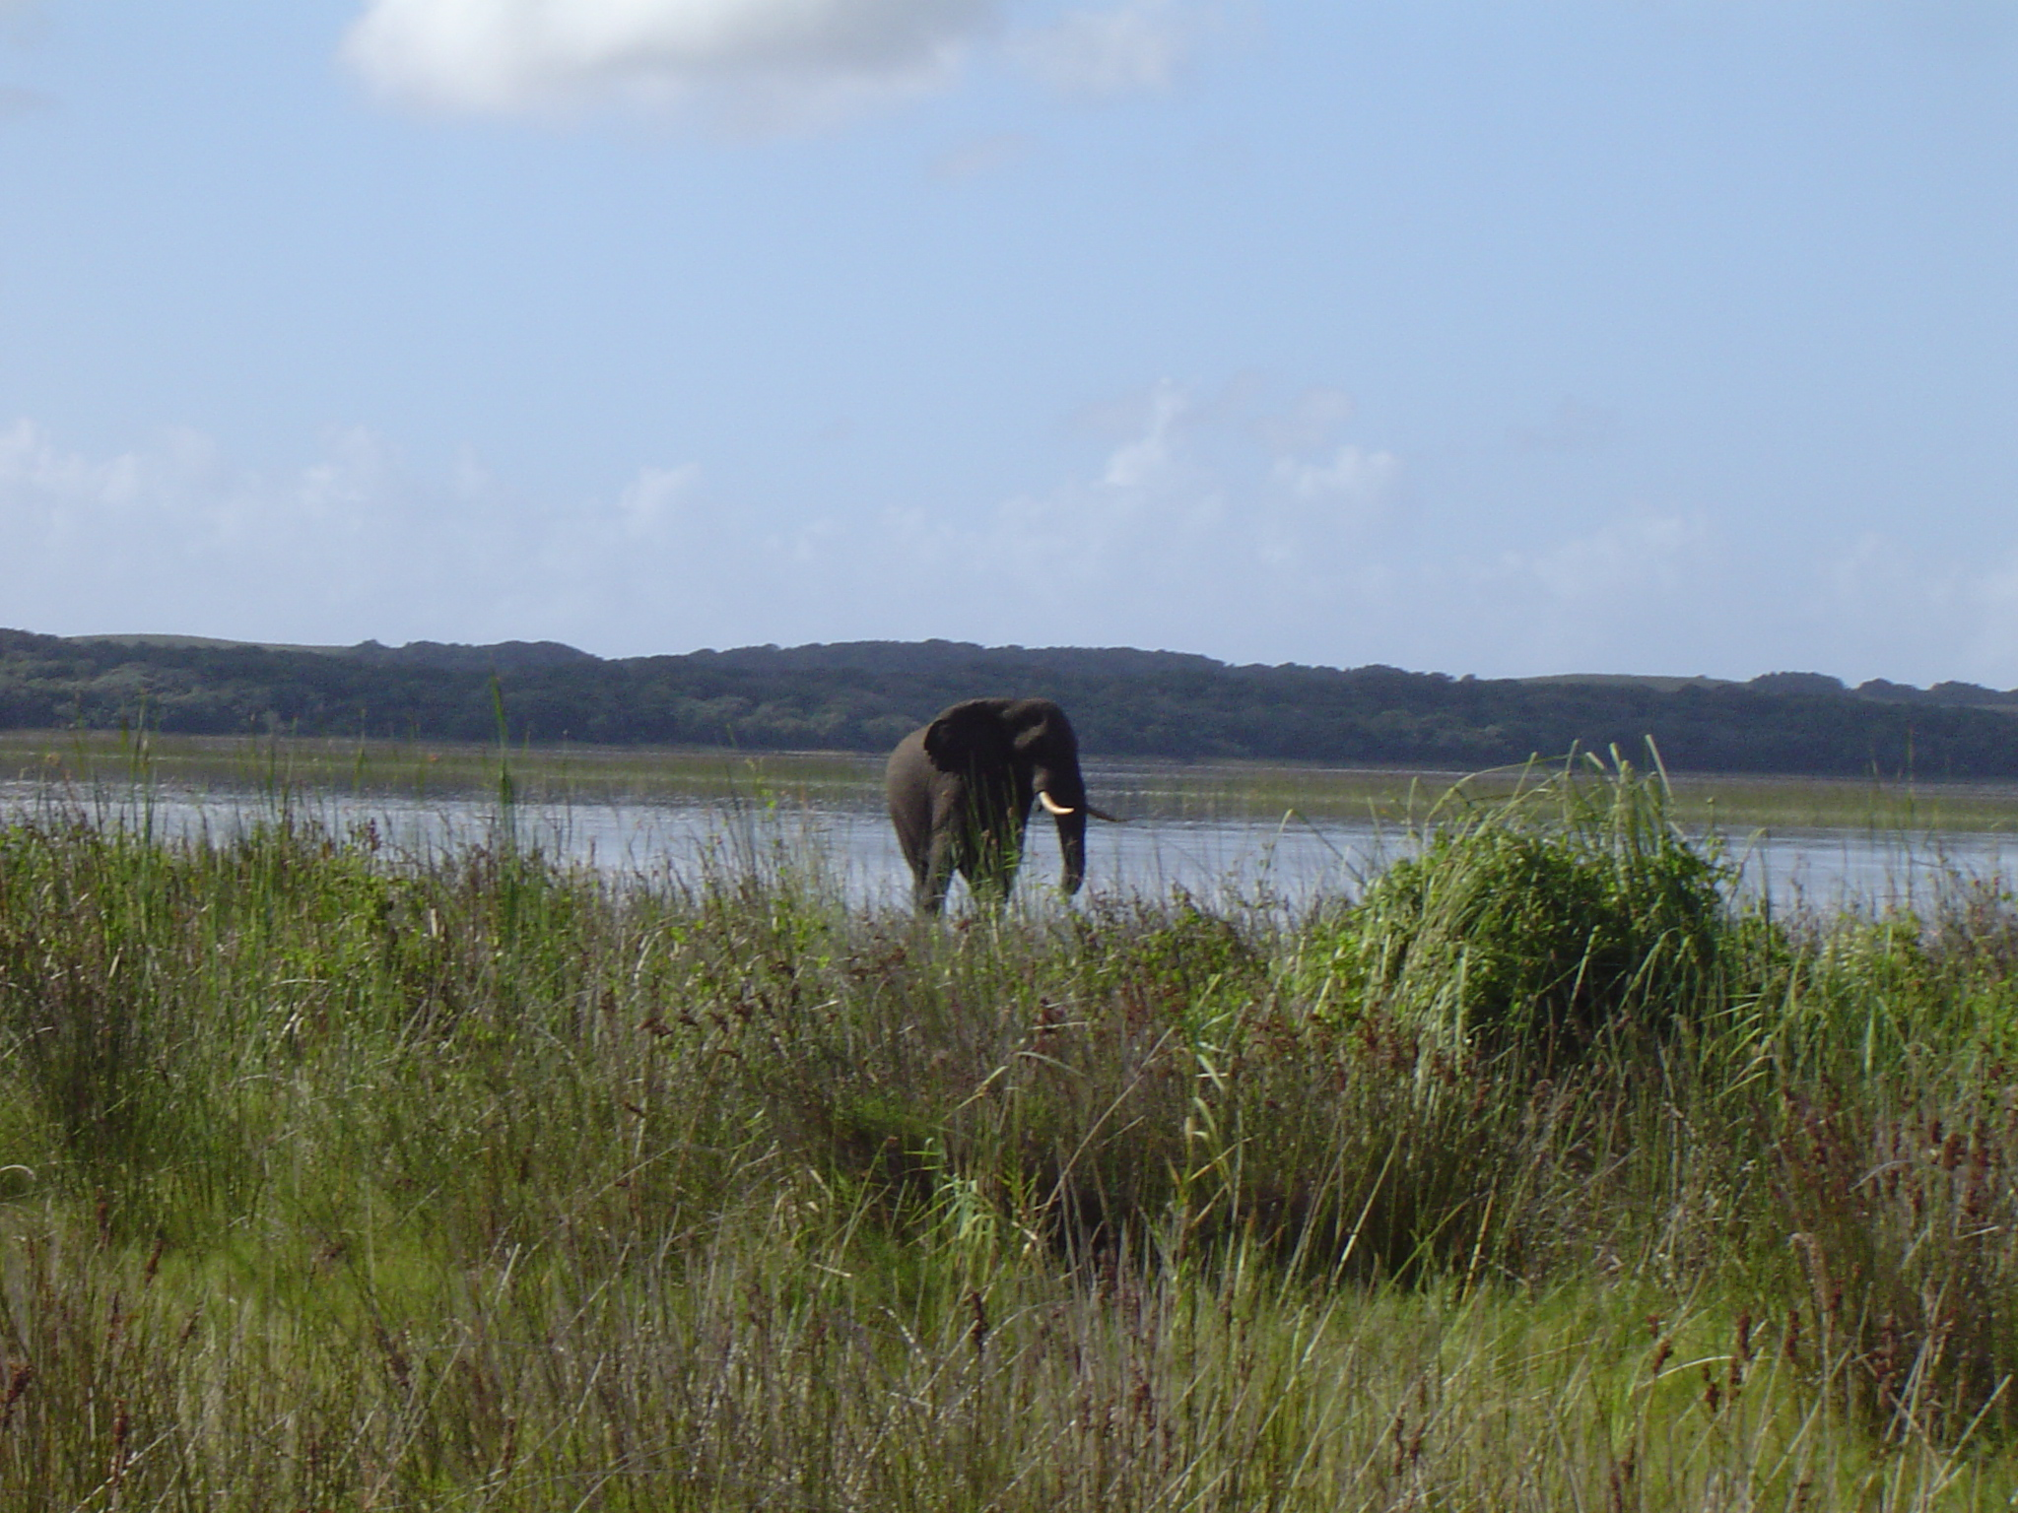
MAPUTO NATIONAL PARK

Slide 11
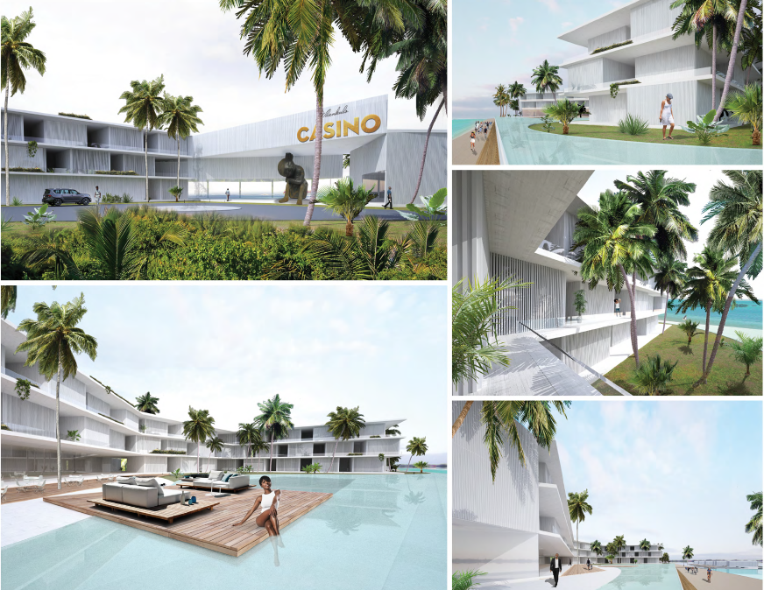
VILANCULOS RESORT CONCEPT
Location: Vilanculos District , Inhambane Province;
Area: 2ha;
Capacity: 150 Rooms (estimated)
In front of Bazaruto Arquipelago
Estimated Budget: 10 million USD

Slide 12
Hotel Inhassoro Restructuring Concept
CHARACTERISTICS:
A1: Reception and Restaurant Building
Refurbishment and reutilisation, taking into account the conservation status of architectural expression and symbolic value
A2: Blocks (two) of symmetrical apartments in band The fully demolish (given its functional inadequacy and constructive precariousness)
A3: A set of isolated dwellings and support services To be demolished (taking in account the level of pre-ruin and functional- constructive mismatching)
Estimated Budget: 9 million USD

Slide 13
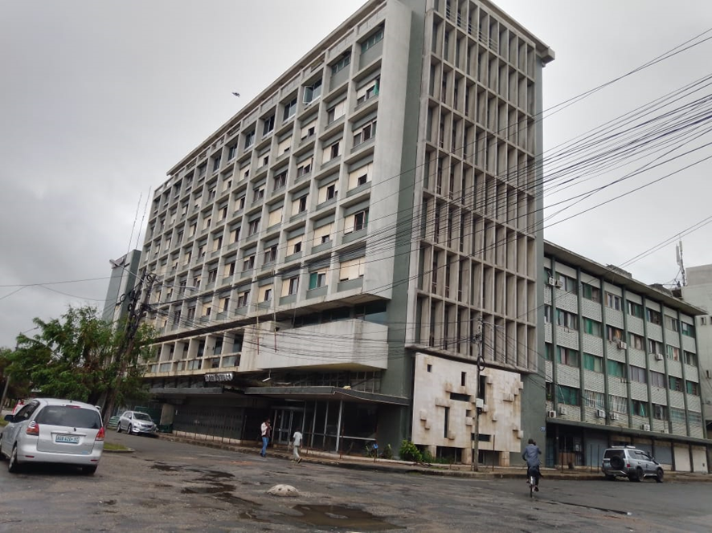
CHUABO HOTEL - Refurbishment and reutilisation
Chuabo Hotel is located in the center of Quelimane City , Zambézia Province, is one of the most emblematic buildings in the city, with a privileged view of the river of good signs and the port of Quelimane. Occupies a constructed area of approximately 7,089 m² and consists of:
9 Floors and annexes, with
3 meeting rooms, 11 executive rooms, 6 suites and 48 double rooms,
1 Restaurants/bar
Estimated Budget: 8 million USD

Slide 14
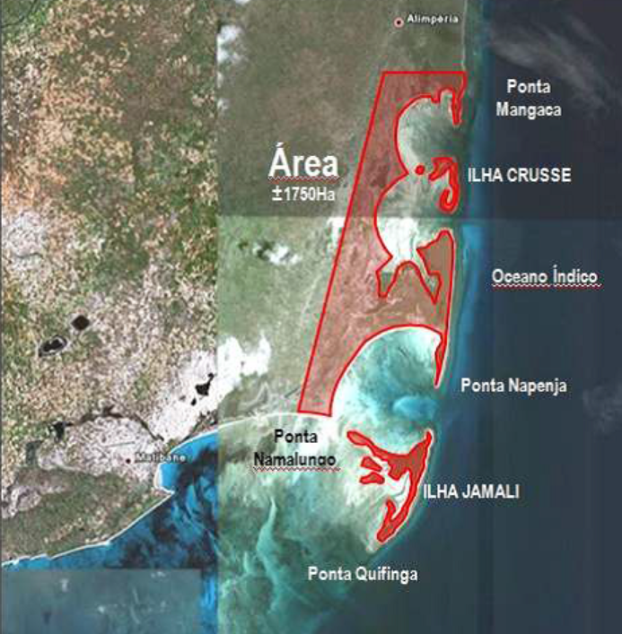
Crusse and Jamali Integrated Tourism Resort Development
01. LOCATION SITE DESCRIPTION
North of Mozambique, Nampula Province
30km off the nearest main road and approximately 150km away from the provincial capital, Nampula;
40km from the Mozambique Island (World heritage site);
Only 50km from Nacala, Eastern Africa’s deepest natural harbor, with a new commercial airport;
The international airport has the second largest landing capacity in the country
02. SIZE
1,750 hectares (Crusse Island -16 hectares, Jamali Island - 75 hectares and mainland 1,750 hectares), with 70% nature preservation.
03. MASTER PLAN
Coming soon
Estimated Budget: 60 million USD

Slide 15
Features
Crusse and Jamali Project is inserted in a Special Economic Zone with best Fiscal Benefits of the country;
It´s a World Class Integrated Resort with investment potential of :
Hotels, Chalets, Casino, Golf Field, Spa, Marina, Hotel School, Private Clinic and a shopping mall;
Potential to create more than 6.000 jobs and will absolve local labor, will create, stimulate self employment as well as entrepreneurship;
Projected to offer more than 5.500 beds.
Infrastructure Requirement
Implementation of a New Road (Design & Construction - aprox 150 km of Road to the location )
Installation of a 12 Megawatt solar Power Plant
Construction of a Health Centre
Construction of Hospitality Training Centre
Water Treatment Plant
Construction of a HUB – Convenience Centre for transport, cultural market, events etc

Slide 16
Pemba Business Hotel Concept
SIZE
Total size is 1.400m²ha,
SITE DESCRIPTION
Cabo Delgado Province is the northern most Province of Mozambique, and boarded by, to the North is the Rovuma River which limits the border with Tanzania, to the South, the River Lurio separating it from the province of Nampula, to the East the Indian Ocean and to the West the province of Niassa;
Largest fan coral in Africa;
Lies on a peninsula in Pemba Bay;
Third largest bay in the world;
Prime destination for water sport and diving enthusiastic as a coral reef lies close to the shore.

Slide 17
CONCEPT DESCRIPTION
Capacity: 42 units (72 Keys) proposed, divided by 3 Areas:
Area 1: Hotel with 27 units;
Area 2: Conference room, SPA, Gym and restaurant/bar;
Area 3: 15 units T2;
Business Hotel Concept
Estimated Budget: 8 million USD

Slide 18
Metangula – Lake Niassa Resort
Located at Niassa Province , Metangula District ,along Lake Niassa
50 Ha available for construction of a unique Tourist Vila Resort with spa, sports center, conferencing facilities, community cultural center and others
KEY ATTRACTIONS:
CAPACITY:
Lake Niassa
Niassa National Reserve
40 beds in Phase 1, expanding to 60 in Phase 2
Estimated Budget: 3 million USD

Slide 19
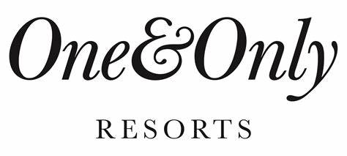
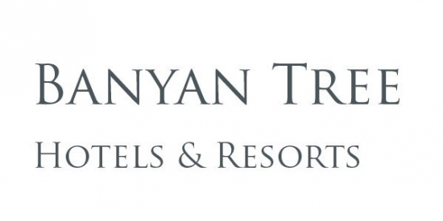
COMING SOON TO MOZAMBIQUE (Hotel Chains)

Slide 20
BUSINESS MODELS
Other Business models may be adopt:
SPV (Special Purpose Vehicle);
BOT (Build Operate and Transfer);
Public Tender

Slide 21
Richard Baulene - CEO
Mozambique Tourism Authority
+ 258 848973821
Info@inatur.gov.mz
Visit Mozambique
THANK YOU

