Slide 1
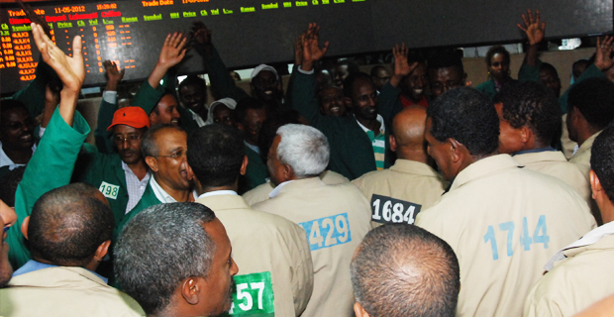
ARAB BUSINESS AND INVESTMENT FORUM IN MOZAMBIQUE Maputo, July 25, 2024
Agricola
U
REPUBLIC OF MOZAMBIQUE
MINISTRY OF INDUSTRY AND TRADE
THE ROLE OF MOZAMBIQUE COMMODITY EXCHANGE IN BOOSTING AGRICULTURAL MARKETS

Slide 2
STRUCTURE OF THE PRESENTATION
INTRODUCTION
OBJECTIVE OF THE PRESENTATION
WHO WE ARE? WHAT WE DO?
CONSTRAINTS EXPERIENCED IN AGRICULTURAL MARKETS
BENEFITS OF USING SINEM (Electronic Platform)
THE EXCHANGE ENABLING ENVIRONMENT
ANY QUESTION?
01
02
03
04
05
06
07

Slide 3
1 - INTRODUCTION
By Decree No. 36/2012, of October 17, the Government created the Mozambique Commodity Exchange, abbreviated as BMM, having approved its respective Organic Statute, now revoked, by Decree No. 9/23, of March 29, with the exception of the first part of article 1, related to its creation. Thus, the BMM was framed under the new legal regime of Public Institutes, now called Mozambique Commodity Exchange, Public Institute, abbreviated as BMM, IP.
BMM,IP aims to establish an organized market for agricultural and non-agricultural commodities, ensuring its organization, functioning, efficiency and transparency in transactions.
In its assignments, BMM, IP is required to maintain and operate environments and information systems suitable for carrying out buying and selling businesses, through auction services, bid trading, futures contracts and other special operations involving any type of commodities, on the stock market, in spot or future settlement modes.
2
3

Slide 4
2 – OBJECTIVE OF THE PRESENTATION
The main objective of this presentation is to share with the distinguished participants of this Forum the operating mechanism of the Commodity Exchange as a Government platform mandated to boost agricultural and non-agricultural marketing in the Country.

Slide 5
3 – WHO WE ARE? WHAT WE DO?
We are the Secondary Market platform
Where buyers and sellers meet to negociate the commodities in person or through an electronic platform,
We add the value to the existing primary market services
We facilitate the intermediation of commodities through:
physical or electronic auctions, offer bidding and futures contracts.
We are also entitled to provide the following additional services:
Dissemination of Market Information (reference prices, quality and quantity of commodities available, their location, etc.)
Grains quality classification and conformity,
Warehouses storage system management with Wharehouse Receipt
Brokerage Services
Physical and Financial Compensation.

Slide 6
4 – CONSTRAINTS EXPERIENCED IN AGRICULTURAL MARKETS
Currently, farmers are struggling with problems accessing the market to sell their production, a scenario that has a negative impact on their production capacity and productivity.
The following constraints stand out:
Lack of ability to determine the quantity, quality and real value of the merchandise;
Lack of appropriate conditions for storing and processing merchandise;
Lack of appropriate conditions for storing and processing merchandise;
Deficiencies in the process of organizing and selling commodities
Poor access to the national financial system;
Low financial income;

Slide 7
5 - SOME BENEFITS OF USING SINEM
It is a sophisticated, organized, transparent, safe and efficient marketing environment, where there is:
01
02
Guarantee of quality standards and quantity of commodities available for purchase or sale,
03
Significant reduction in information asymmetries regarding the market information (reference prices, quality and quantity of commodities, their location in the markets (facilitates decision-making process on where to buy or sell)
04
Facilitates the inclusion of small producers and marketing agents in access to a transparent and fair market, which boosts production and productivity
Facilitates the inclusion of small producers and agricultural and non-agricultural marketing agents in the country's financial and tax systems, through the Warehouse Receipt
05
It covers the public and private sectors operators

Slide 8
6 - THE EXCHANGE ENABLING ENVIRONMENT
SINEM
Electronic Auctions for exports and local industry
Market information
General Operations Regulation
Exclusive transactions regime for selected commodities (maize, peageon peas and soybeans)
Procedures for transactions
BMM,IP transformed into Public Company
Brokarage services
Looking for investors for partnership
Connected to warehouse system for warehouse Receipt emission
Enabling legal framework

Slide 9
7 – ANY QUESTION?
15

Slide 10
THANK YOU!
Notes:
i

